Slide 1
Lecture 4
Top-Down Parsing

Slide 2
Review from Last Time
Goal of syntax analysis: recover the syntax structure of the program.
Idea:
Use a context-free grammar to describe the programming language.
Given a sequence of tokens, look for a parse tree that represents the syntax structure of those tokens. Recovering this syntax tree is called parsing.

Slide 3
Different Types of Parsing
Top-Down Parsing (this section)
Beginning with the start symbol, try to guess the productions to apply to end up at the user's program.
Bottom-Up Parsing (next section)
Beginning with the user's program, try to apply productions in reverse to convert the program back into the start symbol

Slide 4
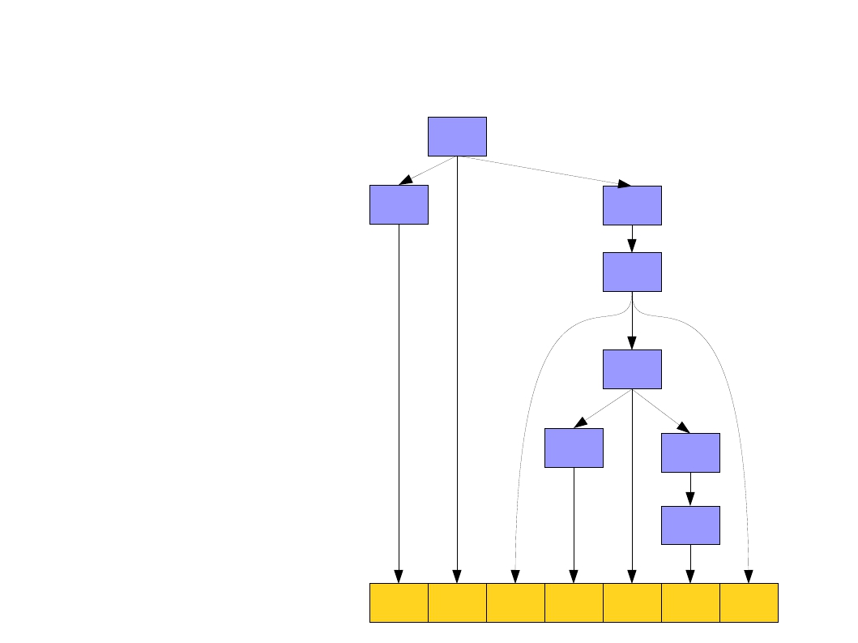
Top-Down Parsing
E
E → T
E → T + E
T → int
T → (E)
T
E
T
E
E ⇒ T + E
⇒ int + E
⇒ int + T
⇒ int + (E)
⇒ int + ( T + E )
⇒ int + ( int + E )
⇒ int + ( int + T )
⇒ int + ( int + int )
T
E
T
int +
( int + int )

Slide 5
Top-Down Parsing
Definition
Parsing begins with the start symbol of grammar,
by steps of derivation, tries to find out the leftmost derivation of the input string
The construction of Parse Tree
Start symbol of grammar is the root, parse tree is constructed from the root to leaves in preorder, the leaves of the parse tree are just input string of tokens

Slide 6
Example G：S → cAd A → ab A → a
Top-down parsing of string “cabd”
Derivation:
S
=>cAd
=>cabd
S
c
A
d
a
b

Slide 7
Parsing as a Search
An idea: treat parsing as a graph search
Each node is a sentential form (a string of terminals and nonterminals derivable from the start symbol).
There is an edge from node α to node β iff α ⇒ β.

Slide 8
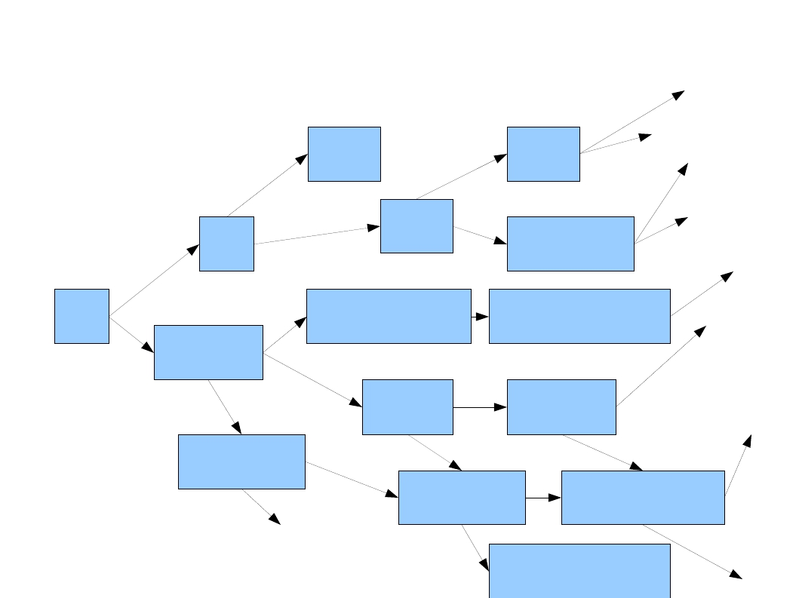
Parsing as a Search
…
E →
E →
T →
T →
T
T + E
int
(E)
…
int
(T)
(T + E)
…
…
…
(E)
T
E
T+T+E
T+T
int + T + E
T + (E)
…
…
T+E
int + E
int + T
int + (E)
…
int + int
…

Slide 9
The Key of Top-down Parsing
So the key problem of top-down parsing is the choice of a production for a derivation step
If the leftmost nonterminal to be replaced is B, there are totally n productions of B: B→A1|A2|…|An, how can we determine which one to use?

Slide 10
Categories of Top-down parsing
Backtracking Parsing (Depth-First)
If a nonterminal has more than one productions, based on the current input symbol, the parser can’t determine which one to choose
it must try different possibilities if one possibility fails.
But backtracking (depth-first) can make it slow
Predictive parsing
Parser attempts to predict the next construction in the input string using one or more look-ahead tokens
Two Kinds of Predictive Parsing
Recursive-descent parsing
LL(1) parsing

Slide 11
OutLine
4.1 The Condition of Predictive Parsing
4.2 Recognition of LL(1) Grammar
4.3 Non LL(1) grammar to LL(1) grammar
4.4 Recursive-Descent Parsing
4.5 LL(1) Parsing
4.6 Error Recovery in Top-Down Parsers

Slide 12
The Condition of Predictive Parsing
Parsing of the input string begins with the start symbol of the grammar
If it can uniquely determine which production to use next in derivation based on lookahead tokens in the input, parsing is predictive
Predictive parsers accept LL(k) grammars
L means “left-to-right” scan of input
L means “leftmost derivation”
k means “need ≤ k tokens of lookahead to predict”
In practice, LL(1) grammars is used.

Slide 13
The Condition of Predictive Parsing
The Condition of Predictive Parsing
Predictive parsing require that the grammar must be a LL(1) grammar
The definition of LL(1) grammar depends on the definition of lookahead sets--First set and Follow set
The Definition of Lookahead Sets
The Definition of LL(1) Grammar

Slide 14
a The Definition of Lookahead Sets
First Sets
Definition
G=(V_{N}, V_{T}, P, S) is a grammar, β∈(V_{N}∪V_{T})*
FIRST(β) = { a ∈V_{T} | β ⇒* a......}
if β⇒* ε then ε ∈FIRST(β)
Intuitively, the first set of string β is the set of first terminals (including ε) that can be derived from β

Slide 15
Example G[S]:
S→Ap
S→Bq
A→a
A→cA
B→b
B→dB
FIRST(Ap)={a,c}
FIRST(Bq)={b,d}
FIRST(a)={a }
FIRST(cA)={c}
FIRST(b)={b}
FIRST(dB)={d}
If there are more than one productions of nonterminal
A: A → α | β|…,but FIRST(α) ∩ FIRST(β) = Φ…, this grammar can be predictive parsed. Basing on the current input symbol which production to choose is determined

Slide 16
Follow Sets
Definition
G=(V_{T}, V_{N}, S,P) is a grammar，A∈V_{N} ，
FOLLOW(A)={a ∈V_{T} |S=>*…Aa…}，
if S=>* …A, then $ ∈FOLLOW(A)
($ is used to mark the end of the input)
Intuitively, the follow set of nonterminal A is the set of terminals (including $) following A in all sentential form of the grammar

Slide 17
Example G₃[S]: S→aA|d A→bAS|ε
There are two productions of nonterminal A:
A→bAS , A→ε，
S ⇒ *aA ,$ ∈FOLLOW(A)
S ⇒ *abAS ⇒ *abAaA, a ∈FOLLOW(A)
… ⇒ *abAd , d ∈FOLLOW(A)
FOLLOW(A)={$,a,d}
Let the current input symbol is “x”
if x ∈FIRST(bAS)={b} ,then choose A→bAS for derivation
if x ∈FOLLOW(A)={$,a,d } , then choose A→ε for derivation
Because FIRST(bAS)∩FOLLOW(A)= Φ , which production to choose is determined

Slide 18
b The Definition of LL(1) Grammar
A grammar is LL(1) grammar if the following conditions are satisfied:
For each production A → α₁|α₂|…|α_{n} , for all i and j, 1≤i, j ≤ n, i≠j , First(α_{i}) ∩First(α_{j}) = Φ
For each nonterminal A such that First(A) contains ε, First(A) ∩Follow(A) = Φ.

Slide 19
Example G[S] ：
S→aAS
S→b
A→bA
A→ε
First(A)={b, ε}
Follow(A)= {a,b}
Because First(A)∩Follow(A)={b}≠Φ,
G[S] is not a LL(1) grammar, when the leftmost nonterminal to be replaced is A and the current input symbol is “b”, parsing can’t determine which productions of A to choose :A→bA or A→ε

